Slide 1

EX3030/EM4012 Heat, Mass and Momentum Transfer Transient Heat Transfer 2
Originally by Dr Mark Stewart
Presented by Dr M. Bannerman

Slide 2
Recap
Lumped Capacitance Method (LCM)
Small objects with high thermal conductivity can often be modelled as ‘lumps’ with a single, uniform temperature that varies only with time, $$T\left(t\right)$$
Governing equation of LCM:
$$\boxed{\frac{T\left(t\right)−T_{∞}}{T_{i}−T_{∞}}=e^{−bt}} where b=\frac{hA_{s}}{ρVC_{p}}$$
The validity of the approach needs to be checked for a given problem:
$$Bi=\frac{Conduction resistance within the body}{Convection resistance at the surface}=\frac{\left(\frac{L_{c}}{k}\right)}{\left(\frac{1}{h}\right)}=\frac{hL_{c}}{k}$$
Approach is valid when Bi < 0.1
EX3030/EM40JN

Slide 3
Transient Heat Transfer
Methods of Analysis
Lumped System Analysis (or Lumped Capacitance Method)
Temperature is a function of time only $$T\left(t\right)$$
Analytical Methods
Temperature is a function of time and one space coordinate $$T\left(x,t\right)$$
Numerical Methods
Temperature is a function of time and all three space coordinates $$T\left(x,y,z,t\right)$$
Increasing complexity
Increasing generality
EX3030/EM40JN

Slide 4
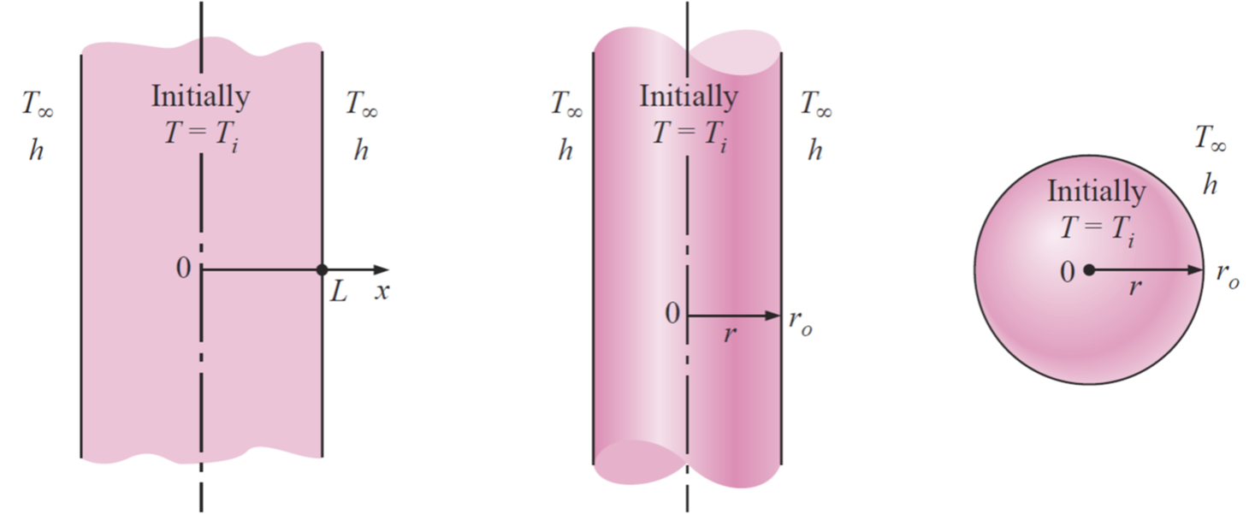
Analytical Methods
Introduction
For Biot number > 0.1, we can no longer assume $$T\left(t\right)$$ and we need an alternative approach to accurately model transient heat transfer processes for $$T\left(x,y,z,t\right)$$
Analytical methods can be applied to solve the simplest of these cases, i.e., when $$T\left(x,t\right)$$
There are three commonly encountered geometries where we can make this assumption
Plane Wall Long Cylinder Sphere
EX3030/EM40JN

Slide 5
Heat Equation
We first simplify and non-dimensionalise the heat equation:
Heat equation for 1-D geometry i.e. $$T\left(x,t\right)$$:
$$\frac{∂^{2}T}{∂x^{2}}=\frac{1}{α}\frac{∂T}{∂t}$$
with initial conditions:
$$T\left(x,t=0\right)=T_{i}$$
and boundary conditions:
$$\frac{∂T}{∂x}\left(x=0,t\right)=0 and −k\frac{∂T}{∂x}\left(x=L,t\right)=h\left(T\left(x=L,t\right)−T_{∞}\right)$$
After non-dimensionalising the heat equation becomes:
$$\frac{∂^{2}θ}{∂X^{2}}=\frac{∂θ}{∂τ}$$
and initial and boundary conditions become:
$$θ\left(X,τ=0\right)=1 , \frac{∂θ}{∂X}\left(X=0,τ\right)=0 and \frac{∂θ}{∂X}\left(X=1,τ\right)=−Bi∙θ$$
EX3030/EM40JN

Slide 6
Dimensionless Variables
There are 4 dimensionless variables
Dimensionless temperature
$$θ\left(x,t\right)=\frac{T\left(x,t\right)−T_{∞}}{T_{i}−T_{∞}}$$
Dimensionless spatial coordinate
$$X=\frac{x}{L} and R=\frac{r}{r_{o}}$$
Dimensionless heat transfer coefficient (Biot Number)
$$Bi=\frac{hL_{c}}{k} or Bi=\frac{hr_{o}}{k}$$
Note: These have two different definitions, as $$L_{c}=\frac{V}{A}=\frac{\frac{4}{3}{πr}^{3}}{{4πr}^{2}}=\frac{r}{3}≠r_{o}{πr}^{3}$$. Note the critical Biot number changes, but use whatever definition the tables/graph use.
Dimensionless time (Fourier Number)
$$τ=\frac{αt}{L^{2}} and τ=\frac{αt}{r_{o}^{2}}$$
$$\left(α=\frac{k}{ρC_{p}}\right)$$
EX3030/EM40JN

Slide 7
Solution Methods
There are two approaches to the solution of analytical heat transfer problems
One-term approximation and look-up tables
Temperature charts of Heisler and Gröber
These approaches are only strictly valid when Fourier Number $$τ>0.2$$
EX3030/EM40JN

Slide 8
Temperature Changes
Approach 1: One term approximations
Plane wall
$$θ_{w}=\frac{T\left(x,t\right)−T_{∞}}{T_{i}−T_{∞}}=A_{1}e^{−λ_{1}^{2}τ}\cos\left(λ_{1}X\right)$$
Cylinder
$$θ_{c}=\frac{T\left(r,t\right)−T_{∞}}{T_{i}−T_{∞}}=A_{1}e^{−λ_{1}^{2}τ}J_{0}\left(λ_{1}R\right)$$
Sphere
$$θ_{s}=\frac{T\left(r,t\right)−T_{∞}}{T_{i}−T_{∞}}=A_{1}e^{−λ_{1}^{2}τ}\frac{\sin\left(λ_{1}R\right)}{λ_{1}R}$$
At the centreline
$$θ_{0}=\frac{T_{0}−T_{∞}}{T_{i}−T_{∞}}=A_{1}e^{−λ_{1}^{2}τ}$$
$$A_{1}$$ and $$λ_{1}$$ are coefficients, dependent only on the Bi number
$$J_{0}$$ is zeroth order Bessel function of 1st kind
Expression for $$θ_{0}$$ is the same for all three geometries
EX3030/EM40JN

Slide 9
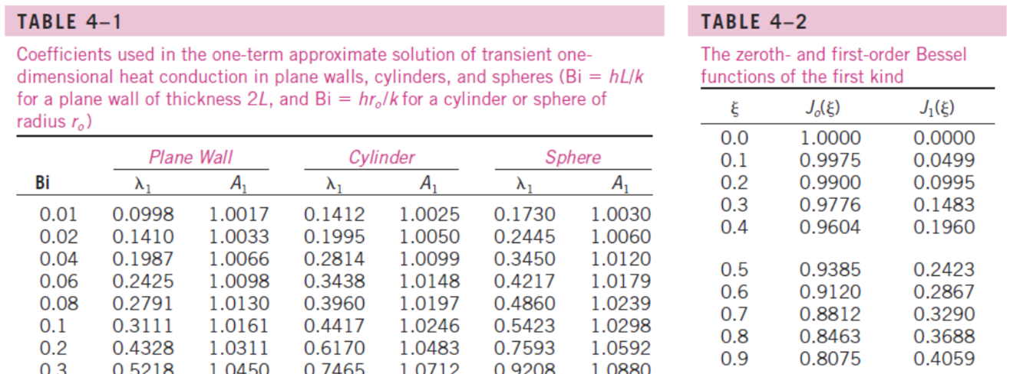
Temperature Changes
Approach 1: Look up tables
The values of $$λ_{1}$$, $$A_{1}$$ $$J_{0}\left(ξ\right)$$ and $$J_{1}\left(ξ\right)$$ have been tabulated for ease of reference:
Note, interpolation is usually required to get the required values
EX3030/EM40JN

Slide 10
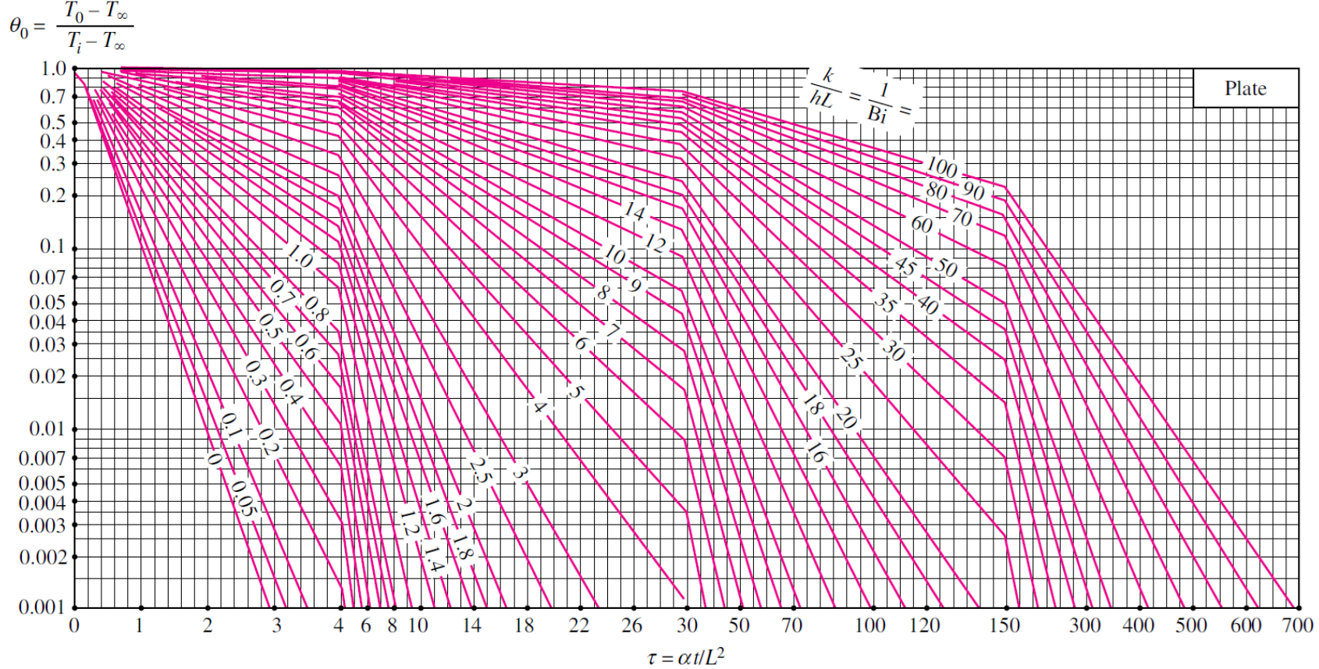
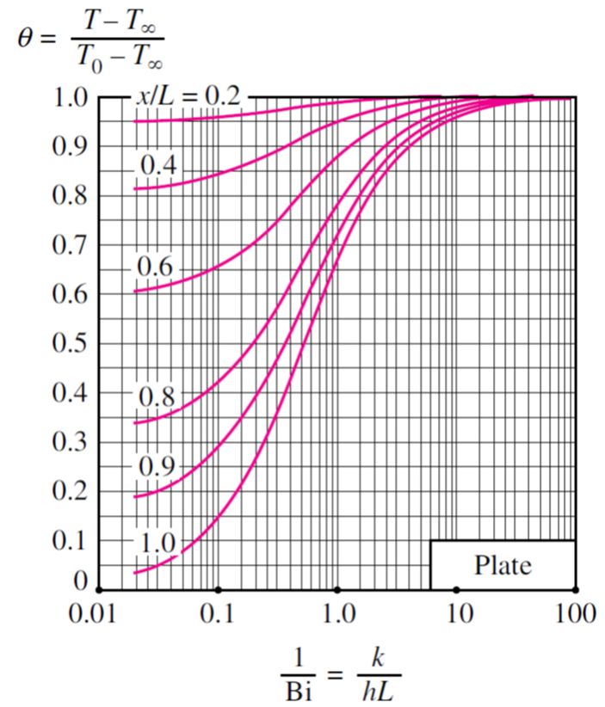
Temperature Changes
Approach 2: Heisler charts
$$θ_{0}=\frac{T_{0}−T_{∞}}{T_{i}−T_{∞}}$$
Chart 1: for determining the centreline temperature $$T_{0}\left(t\right)$$ at any given time $$t$$
Chart 2: get the temperature $$T\left(x,t\right)$$ at any given location $$x$$ and time $$t$$
$$τ=αt/L^{2}$$
Note, showing examples for plate/plane wall geometry – similar charts available for sphere and cylinder geometries too
EX3030/EM40JN

Slide 11
Worked Eggsample 1
Let’s try again to figure out how long to boil our egg…
The scenario (from Cengel, 2002, p224):
An ordinary egg can be approximated as a 5 cm diameter sphere. The egg is initially at a uniform temperature of 5°C and is dropped into boiling water at 95°C. Taking the convection heat transfer coefficient to be h = 1200 W/m^{2·}°C, determine how long it will take for the centre of the egg to reach 70°C.
EX3030/EM40JN

Slide 12
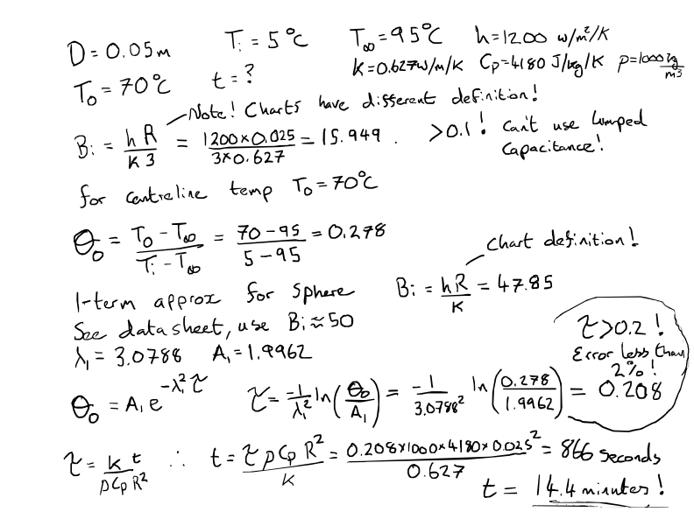
Solution

Slide 13
Estimating Heat Transfer
In addition to temperature, we can also make some estimations of maximum and actual heat transfer
Approach 1: One term approximations
Plane wall
$${\left(\frac{Q}{Q_{max}}\right)}_{w}=1−θ_{0}\frac{\sin\left(λ_{1}\right)}{λ_{1}}$$
Cylinder
$${\left(\frac{Q}{Q_{max}}\right)}_{s}=1−2θ_{0}\frac{J_{1}\left(λ_{1}\right)}{λ_{1}}$$
Sphere
$${\left(\frac{Q}{Q_{max}}\right)}_{c}=1−3θ_{0}\frac{\sin\left(λ_{1}\right)−λ_{1}\cos\left(λ_{1}\right)}{λ_{1}^{3}}$$
$$A_{1}$$ and $$λ_{1}$$ are coefficients, dependent only on the Bi number
$$J_{1}$$ is first order Bessel function of 1st kind
EX3030/EM40JN

Slide 14
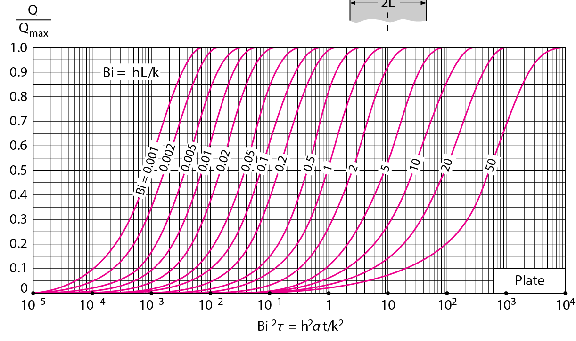
Estimating Heat Transfer
Approach 2: Gröber charts
EX3030/EM40JN

Slide 15
Engineering Madness
At this point, I was entirely unhappy with the solution for eggs, so I built a Finite Element Simulation here https://colab.research.google.com/github/toastedcrumpets/HMMT/blob/master/UnsteadyHeat/unsteady_heat_rod.ipynb

Slide 16
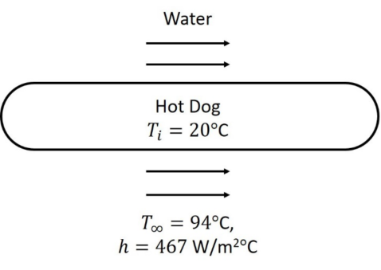
Worked Example 2
A hot dog, initially at a uniform temperature of 20°C, is dropped into a pan of boiling water, which is at a temperature of 94°C. The convection heat transfer coefficient between the hot dog and the water is ℎ = 467 W/m²℃
The hot dog is 12.5 cm long and 2.2 cm in diameter with the following properties:
Specific heat capacity, $$C_{p}$$ = 3,900 J/kg·°C
Density, $$ρ$$ = 980 kg/m³
Thermal conductivity, $$k$$ = 0.771 W/m·°C
Determine the centre and the surface temperatures of the hot dog 4 minutes after the start of cooking
Determine the amount of heat transferred to the hot dog
EX3030/EM40JN

Slide 17
Solutions
See Hot-dog-solution on notes site.

Slide 18
Background Assumptions
There are some limiting assumptions inherent in the analytical approach
The following are some conditions for using the Heisler and Gröber charts that you should be aware of:
the body is initially at a uniform temperature;
the temperature of the surroundings is constant and uniform;
the convective heat transfer coefficient is constant and uniform and;
there is no heat generation in the body.
EX3030/EM40JN

Slide 19
Summary
Summary of the Analytical Methods
Applicable to simplified one-dimensional geometries: plane wall, cylinder and sphere
Two approaches to solve the problems: (1) 1-term approximation and look up tables or (2) Heisler and Gröber charts
Choice of equation and chart depends on the geometry of the problem
Can use the technique to understand temperature distribution at different locations within the body at different times and calculate corresponding heat transfer
Valid for situations where Fourier number $$τ>0.2$$
EX3030/EM40JN

Slide 20
Thanks for your attention
EX3030/EM40JN

